Slide 1

CSE (H) with specialization in Machine Learning and Artificial Intelligence
Soft Computing (20CST-345)
Chapter -3.3
Introduction to Genetic Algorithms
By: Dr. Monika Singh E11032
DISCOVER . LEARN . EMPOWER

Slide 2
Course Objectives
To introduce soft computing concepts and techniques of artificial neural networks, fuzzy sets, fuzzy logic and genetic algorithms
To understand the various techniques from the application point of view.
To analyze various soft computing techniques and decide the technique to be used in a particular problem situation.
To implement soft computing based solutions for real-world problems
DISCOVER . LEARN . EMPOWER

Slide 3
Course Outcomes
CO1 | Identify and describe soft computing techniques and their roles in building intelligent. Machines | 1
CO2 | Recognize the feasibility of applying a soft computing methodology for a particular problem. | 2,4
CO3 | Apply fuzzy logic and reasoning to handle uncertainty and solve engineering problems, genetic algorithms to combinatorial optimization problems and neural networks to pattern classification and regression problems. | 3
CO4 | Effectively use modern software tools to solve real problems using a soft computing approach. | 3
CO5 | Evaluate various soft computing approaches for a given problem. | 4
DISCOVER . LEARN . EMPOWER

Slide 4
Table of Contents
History of Genetic Algorithms (GA), Fundamentals of Genetic Algorithms, Encoding, Operators of Genetic Algorithm, Basic Genetic Algorithm.
DISCOVER . LEARN . EMPOWER

Slide 5

Introduction to Genetic Algorithms
DISCOVER . LEARN . EMPOWER

Slide 6
Genetic Algorithm (2) – Basic Algorithm
Starting with a subset of n randomly chosen solutions from the search space (i.e. chromosomes).
This is the population.
This population is used to produce a next generation of individuals by reproduction.
Individuals with a higher fitness have more chance to reproduce (i.e. natural selection).
DISCOVER . LEARN . EMPOWER

Slide 7
Comparison of Natural and GA Terminology
Natural | Genetic Algorithm
Chromosome Gene Allele Locus Genotype Phenotype | String Feature or character Feature value String position Structure Parameter set, a decoded structure
DISCOVER . LEARN . EMPOWER

Slide 8
Genetic Algorithm (3) – Basic Algorithm
Outline of the basic algorithm
0 START : Create random population of n chromosomes
1 FITNESS : Evaluate fitness f(x) of each chromosome in the population
2 NEW POPULATION
1 REPRODUCTION/SELECTION : Based on f(x)
2 CROSS OVER : Cross-over chromosomes
3 MUTATION : Mutate chromosomes
3 REPLACE : Replace old with new population: the new generation
4 TEST : Test problem criterium
5 LOOP : Continue step 1 – 4 untill criterium is satisfied
DISCOVER . LEARN . EMPOWER

Slide 9
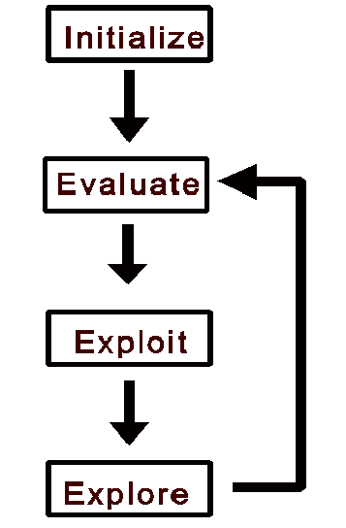
All individuals in population
evaluated by fitness function.
Individuals allowed to
reproduce (selection),
crossover, mutate.
Flowchart of GA
DISCOVER . LEARN . EMPOWER

Slide 10
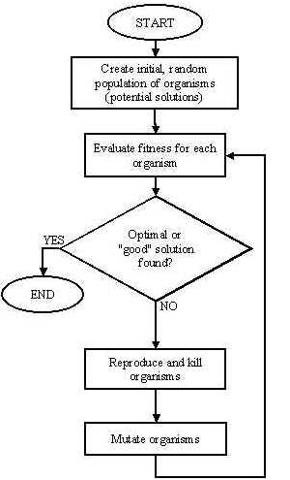
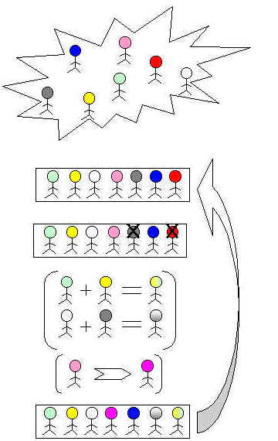
DISCOVER . LEARN . EMPOWER

Slide 11
Holland, J. (1992), Adaptation in natural and artificial systems , 2nd Ed. Cambridge: MIT Press.
Davis, L. (Ed.) (1991), Handbook of genetic algorithms. New York: Van Nostrand Reinhold.
Goldberg, D. (1989), Genetic algorithms in search, optimization and machine learning. Addison-Wesley.
Fogel, D. (1995), Evolutionary computation: Towards a new philosophy of machine intelligence. Piscataway: IEEE Press.
Bäck, T., Hammel, U., and Schwefel, H. (1997), ‘Evolutionary computation: Comments on the history and the current state’, IEEE Trans. On Evol. Comp. 1, (1)
References
DISCOVER . LEARN . EMPOWER

Slide 12
Online Resources
http://www.spectroscopynow.com
http://www.cs.bris.ac.uk/~colin/evollect1/evollect0/index.htm\
IlliGAL (http://www-illigal.ge.uiuc.edu/index.php3)
GAlib (http://lancet.mit.edu/ga/)
DISCOVER . LEARN . EMPOWER

Slide 13
References
TEXT BOOKS
T1. Timothy J. Ross, “Fuzzy Logic with Engineering Applications”.
T2. S.N.Sivanandam, S.N Deepa, “Principles of Soft Computing”
T3. Lofti Zadeh “Fuzzy Logic and Soft Computing” Word Scientific, 1995.
T4 Samir Roy,Udit Chakraborty, “Introduction to Soft Computing:Neuro-Fuzzy and Genetic Algorithms”, Pearson.
REFERENCE BOOKS
R1. Bart Kosko, “Neural Network and Fuzzy Systems: A Dynamic System Approach to Machine” Prentice-Hall 1998
R2. Fausett, “Fundamentals of Neural Networks: Architectures, Algorithms, and Applications”, Prentice-Hall, 1994
R3. Jack M. Zurada, “Introduction to Artificial Neural Systems”, PWS Publishing Co., Boston, 2000.
R4. J S R Jang, “Neuro-Fuzzy & Soft Computing,”, Pearson.
DISCOVER . LEARN . EMPOWER

Slide 14
Journal Papers
1. C.A. Peña-Reyes. Evolutionary fuzzy modelling human diagnostic decisions. Annals of the New York Academy of Sciences, pages 190-211, May 2004. DOI – PDF
2. C.A. Peña-Reyes and M. Sipper. Evolutionary computation in medicine: An overview. Artificial Intelligence in Medicine, 19(1):1-23, May 2000. DOI
3. C.A. Peña-Reyes and M. Sipper. A fuzzy-genetic approach to breast cancer diagnosis. Artificial Intelligence in Medicine, 17(2):131-155, October 1999. DOI – PDF
4. Jungang Liu, Student Member, IEEE, and Oliver W. W. Yang, Senior Member, IEEE, “Using Fuzzy Logic Control to Provide Intelligent Traffic Management Service for High-Speed Networks”, IEEE TRANSACTIONS ON NETWORK AND SERVICE MANAGEMENT, VOL. 10, NO. 2, JUNE 2013.
Web links
(1) http://staff.cs.upt.ro/~todinca/cad/Lectures/cad_fuzzysets.pdf (2) Principles of Soft Computing
DISCOVER . LEARN . EMPOWER

Slide 15
THANK YOU
For queries
Email: monika.e11032@cumail.in

